Slide 1



TACTICAL COMBAT CASUALTY CARE COURSE
MODULE 1:
PRINCIPLES AND APPLICATION OF TACTICAL COMBAT CASUALTY CARE (TCCC)
TCCC TIER 1
All Service Members
TCCC TIER 2
Combat Lifesaver
TCCC TIER 3
Combat Medic/Corpsman
TCCC TIER 4
Combat Paramedic/Provider

Slide 2
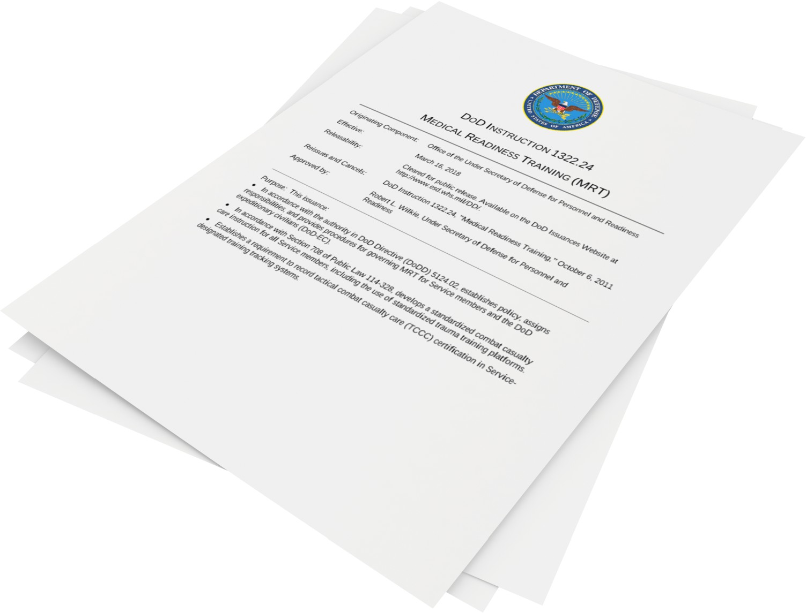
Module 1: Principles and Application of TCCC
NDAA 2017 section 708
DoDI 1322.24
▪
Standardizes Combat Casualty Care for all Service members
▪
Covers the use of a standardized trauma training platform
2

Slide 3




Module 1: Principles and Application of TCCC
TCCC ROLE-BASED TRAINING SPECTRUM
ROLE 1 CARE
NONMEDICAL PERSONNEL
MEDICAL PERSONNEL
YOU ARE HERE
JOINT STANDARDIZED CURRICULUM
3

Slide 4


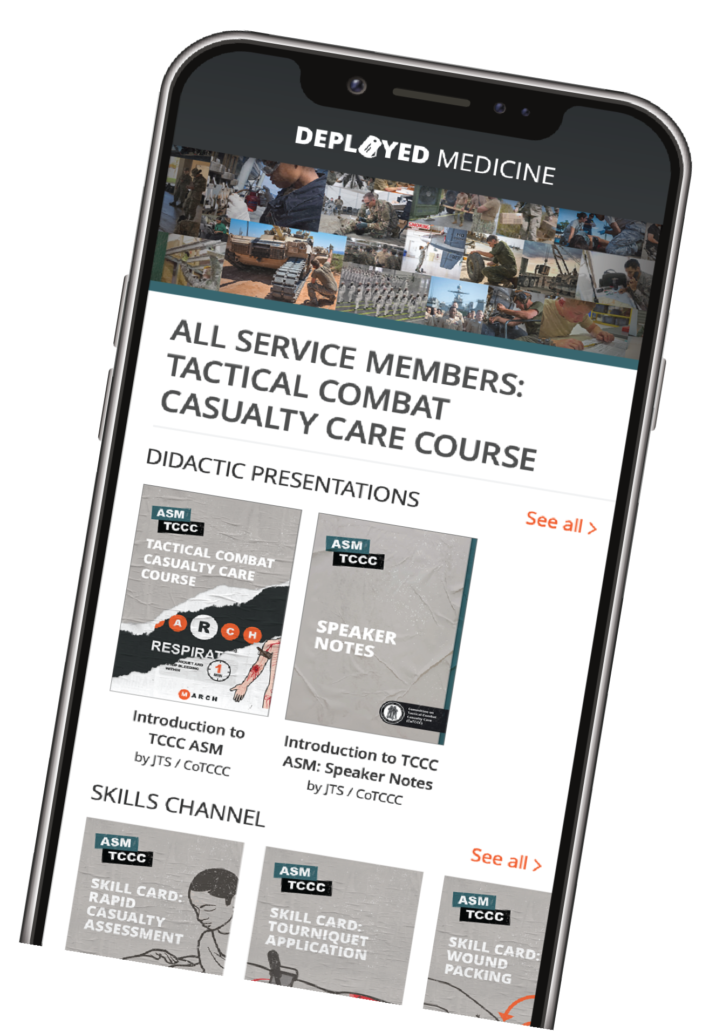



Module 1: Principles and Application of TCCC
This isn’t just your typical first aid training
Training & Education Resource
All Service Members (ASM),Combat Lifesaver (CLS), Combat Medic /Corpsman (CMC), and Combat Paramedic/Provider (CPP) TCCC Curriculum
Updated videos, podcasts, and resources
Download CPGs to your phone
▪
▪
www.deployedmedicine.com
4

Slide 5
Module 1: Principles and Application of TCCC
WHAT THIS COURSE CONTAINS
Principles and Applications of TCCC Medical Equipment
Care Under Fire
Principles and Application of Tactical Field Care Tactical Trauma Assessment
Massive Hemorrhage Control Airway Management
Respiration Assessment and Management Circulation/Hemorrhage Control
Shock Recognition and Management Hemorrhagic Shock Fluid Resuscitation Hypothermia Prevention
Head Injuries Eye Injuries
Pain Medications (Analgesia) Antibiotic Administration Wound Management
Burns Fractures
Casualty Monitoring Communication Cardiopulmonary Resuscitation Documentation
Preparation for Evacuation
5

Slide 6







Module 1: Principles and Application of TCCC
2 x TERMINAL LEARNING OBJECTIVES
01 Given a combat or noncombat scenario, perform Tactical Combat Casualty Care (TCCC) in accordance with the Committee on Tactical Combat Casualty Care (CoTCCC) Guidelines.
1.
1Demonstrate the application of Tactical Combat Casualty Care skills in a combat or noncombat scenario (Comprehensive Module Practical Exercise).
02
Describe the practice of TCCC in accordance with CoTCCC Guidelines.
  Identify the leading causes of preventable death due to traumatic injuries and the corresponding interventions to help increase chances of survival. (ASM T1:E1)
  Describe the TCCC Phases of Care and how intervention priorities differ in each phase, in accordance with CoTCCC Guidelines. (CLS T2:E3)
  Describe the application of TCCC in combat and noncombat settings across different environments. (CLS T2:E4)
  Describe the role and responsibilities of all non-medical and medical personnel in rendering TCCC care in accordance with Joint Publication 4-02 and DoDI 1322.24.
  Identify the key factors influencing TCCC. (CLS T2:E6)
  Identify the importance of TCCC training. (CLS T2:E7)
  Identify the three objectives (or goals) of TCCC. (CLS T2:E8)
  Identify the lifesaving impacts of TCCC implementation in prehospital trauma care.
  Identify methods used to stay current and up to date with TCCC Guidelines and protocols.
10 x ENABLING LEARNING OBJECTIVES
= Cognitive ELOs = Performance ELOs
#
= Terminal Learning Objectives
6

Slide 7

Module 1: Principles and Application of TCCC
Intro to Tactical Combat Casualty Care (TCCC) Overview
Video can be found on deployedmedicine.com

Slide 8
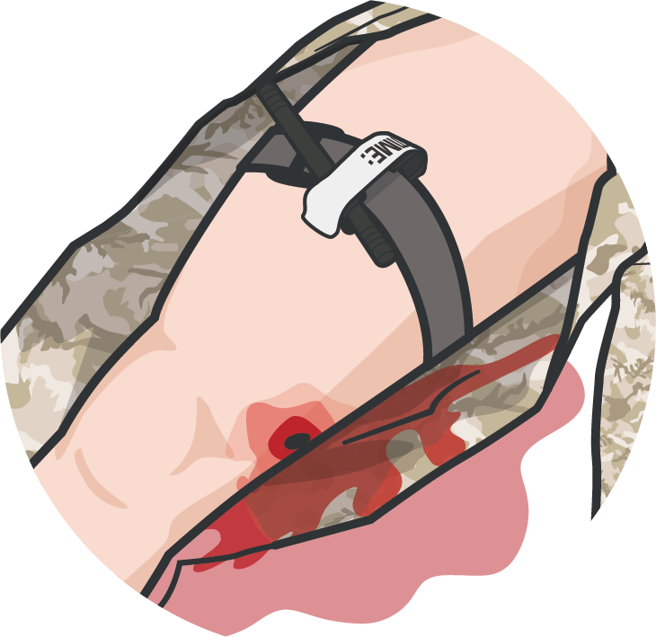
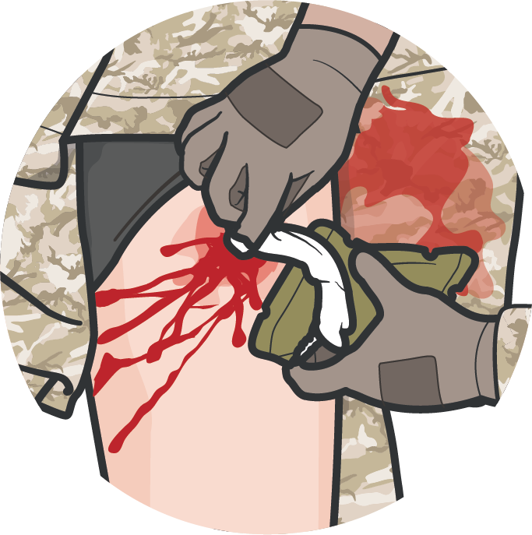
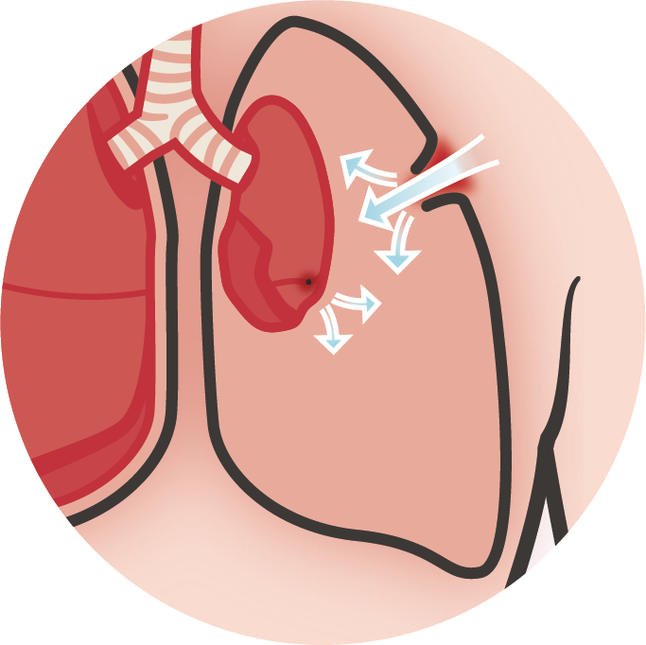
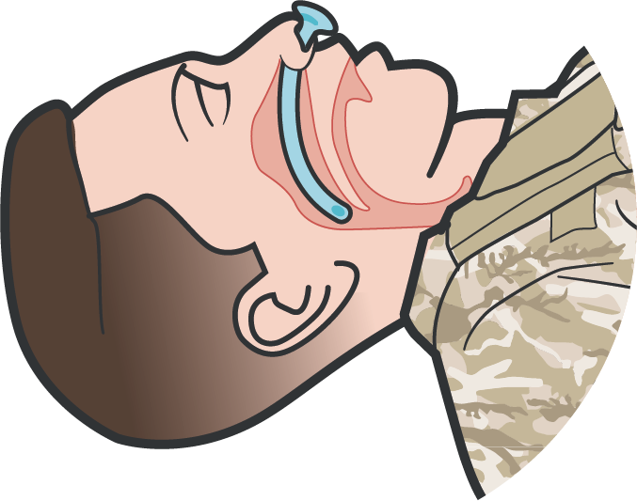
LEADING CAUSES OF PREVENTABLE DEATH DUE TO TRAUMATIC INJURIES
Module 1: Principles and Application of TCCC
EXTREMITY HEMORRHAGE
Intervention:
limb tourniquet
JUNCTIONAL HEMORRHAGE
Intervention: hemostatic dressing and wound packing; junctional tourniquet
TENSION PNEUMOTHORAX
Intervention:
Needle Decompression of the Chest (NDC)
AIRWAY TRAUMA/ OBSTRUCTION
Intervention:
airway maneuvers, nasopharyngeal airway (NPA) or cricothyroidotomy

Slide 9



Three PHASES of TCCC
Module 1: Principles and Application of TCCC
1
CARE UNDER FIRE (CUF)
/ THREAT
2
TACTICAL FIELD CARE (TFC)
WORK UNDER COVER AND CONCEALMENT
3
TACTICAL EVACUATION CARE (TACEVAC)
RETURN FIRE AND TAKE COVER
MORE DELIBERATE ASSESSMENT AND PRE- EVACUATION PROCEDURES
NOTE: This is covered in more advanced TCCC training!

Slide 10


PHASE 1: CARE UNDER FIRE / THREAT
Module 1: Principles and Application of TCCC
RETURN FIRE AND TAKE COVER
DIRECT CASUALTY TO REMAIN ENGAGED
STOP LIFE- THREATENING HEMORRAGE
(if tactically feasible)
NEVER ATTEMPT to
rescue a casualty until hostile fire is suppressed
HAVE CASUALTY MOVE TO COVER AND APPLY SELF-AID
(if able)
HAVE UNIT PERSONNEL MOVE CASUALTY TO COVER
(if casualty is unable
to move)
Using available resources, ensure scene safety
KEEP CASUALTY FROM SUSTAINING ADDITIONAL WOUNDS

Slide 11
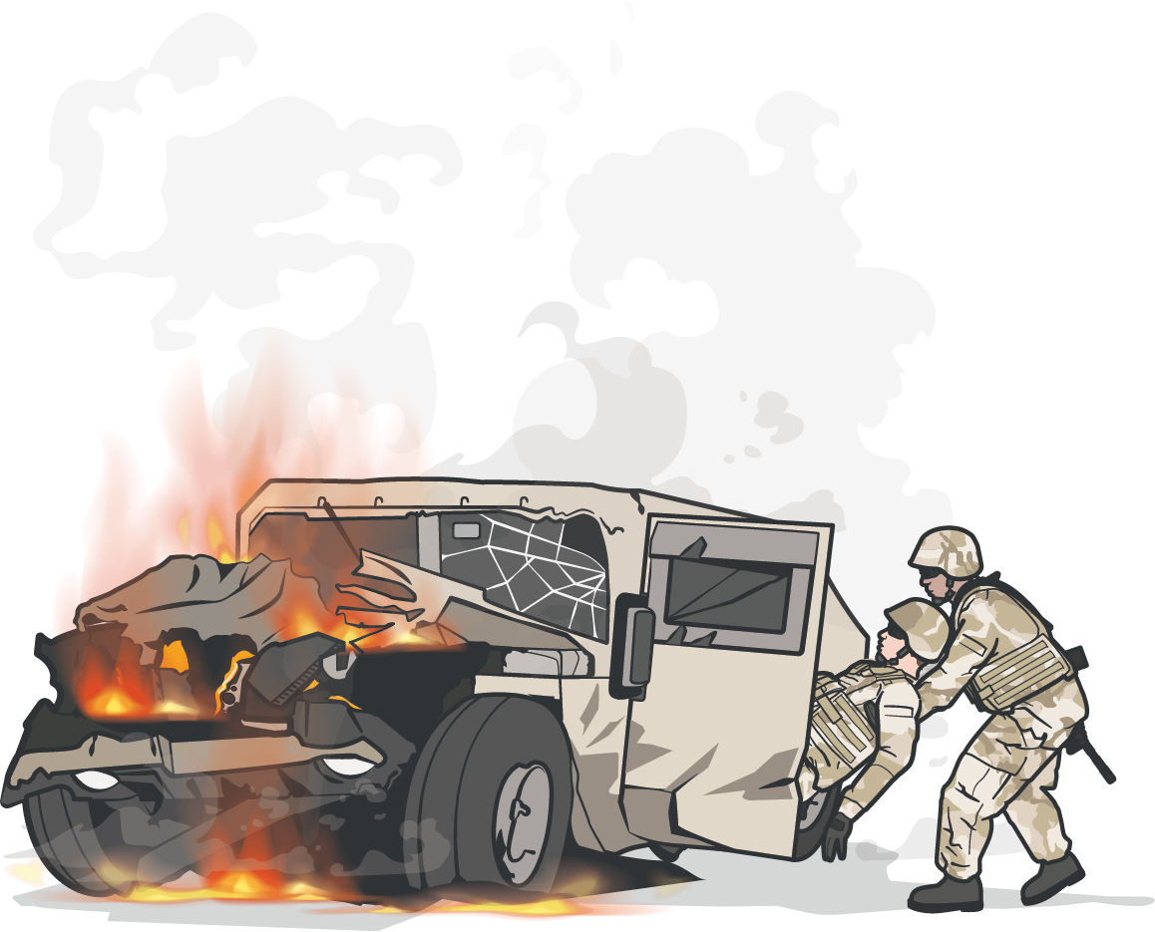
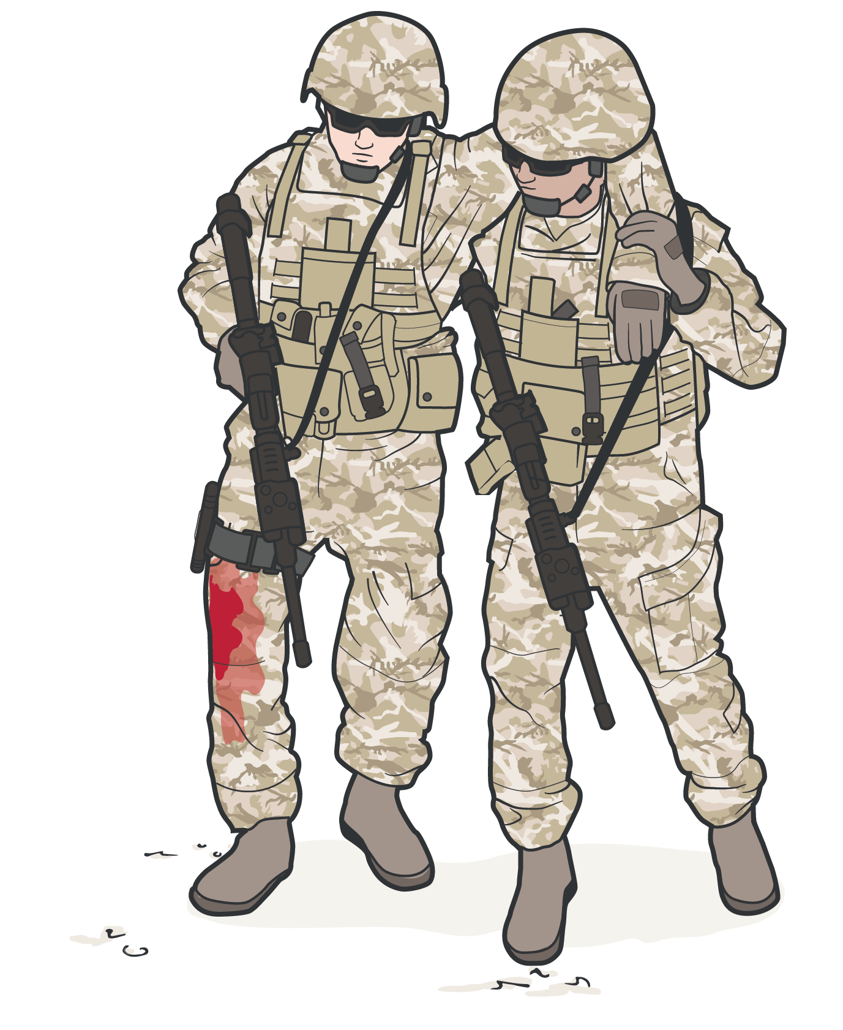


PHASE 1: CARE UNDER FIRE / THREAT (CONT.)
Module 1: Principles and Application of TCCC
CASUALTIES SHOULD BE EXTRACTED AND
MOVED to relative safety once scene is secure
STOP LIFE-THREATENING EXTERNAL HEMORRAGE
(if tactically feasible)
For life-threatening bleeding, place a tourniquet over the uniform "proximal" to the bleeding site(s)
NOTE: If life-threatening bleeding is not readily apparent, place tourniquet as proximal as possible on injured limb
Stop the burning process, if relevant
MOVE CASUALTY
IMPORTANT CONSIDERATION:
Continuously assess risks and make a plan before moving a casualty

Slide 12
MARCH PAWS
Module 1: Principles and Application of TCCC
LIFE-THREATENING (within TFC) AFTER LIFE-THREATENING
M A R C H
MASSIVE BLEEDING
#1 priority
P A W S
PAIN
AIRWAY
ANTIBIOTICS
RESPIRATION (breathing)
WOUNDS
CIRCULATION
SPLINTING
HYPOTHERMIA / HEAD INJURIES

Slide 13
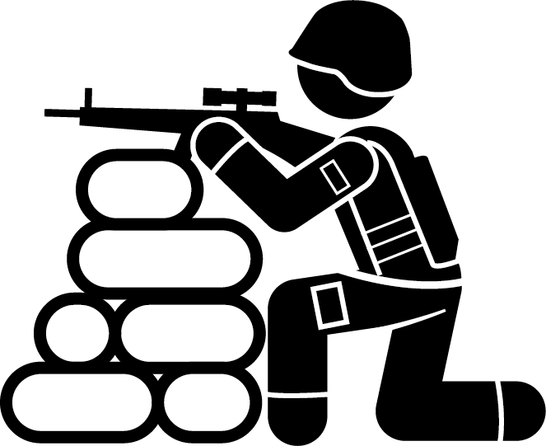





PHASE 2: TACTICAL FIELD CARE
Module 1: Principles and Application of TCCC
ESTABLISH SECURITY PERIMETER
TRIAGE CASUALTIES
ASSESSMENT AND TREATMENT
COMMUNICATION
DOCUMENTATION OF CARE
PREPARATION FOR EVACUATION

Slide 14
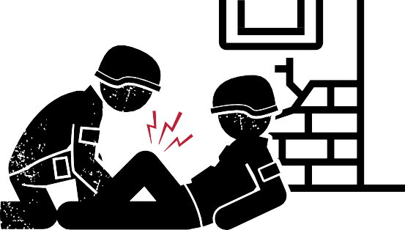

PHASE 2: TACTICAL FIELD CARE (CONT.)
Module 1: Principles and Application of TCCC
TACTICAL FIELD CARE
LIMITED SUPPLIES
The casualty and the person rendering care are not under direct fire
TFC can turn into a
Care Under Fire unexpectedly
Personnel should maintain their
SITUATIONAL AWARENESS
Medical equipment and supplies are limited to what is carried into the field by the CMC, any COMBAT LIFESAVER, and the INDIVIDUAL SERVICE MEMBER
Always use the casualty’s
Joint First Aid Kit (JFAK) first
REMEMBER: Intervention priorities should follow MARCH PAWS

Slide 15
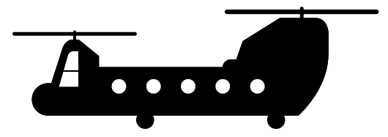

PHASE 3: TACTICAL EVACUATION CARE
Module 1: Principles and Application of TCCC
ESTABLISHING EVACUATION POINT SECURITY
COMMUNICATING PATIENT INFORMATION
STAGING/LOADING CASUALTIES
SECURING CASUALTIES
REASSESSING/ RE-EVALUATING

Slide 16
Three PHASES of TCCC
Module 1: Principles and Application of TCCC
1 CUF
RETURN FIRE AND TAKE COVER
2 TFC
WORK UNDER COVER AND CONCEALMENT
3 TACEVAC
DELIBERATE ASSESSMENT PRE-EVACUATION PROCEDURES
Direct the casualty to remain engaged
Direct the casualty to move to cover
Keep casualty from sustaining additional wounds
Stop life-threatening external hemorrhage
Move casualty to cover
Establish a security perimeter and maintain tactical situational awareness
Triage casualties
Assess and treat following MARCH PAWS sequence
Communicate Document care
Prepare casualty for evacuation
Establish evacuation point security and stage casualties
Communicate patient information to TACEVAC
TACEVAC personnel stage casualties on evacuation platforms
Secure casualties in evacuation platform
Re-assess and re-evaluate all injuries / interventions

Slide 17



Module 1: Principles and Application of TCCC
APPLICATION OF TCCC IN COMBAT VERSUS NONCOMBAT SETTINGS
MOTOR VEHICLE ACCIDENT
ACTIVE SHOOTER
WORKPLACE ACCIDENT
REMEMBER! The principles of TCCC apply to all of these varied-use cases

Slide 18
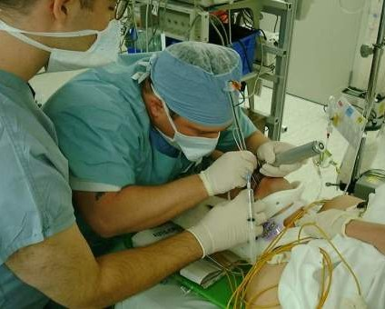
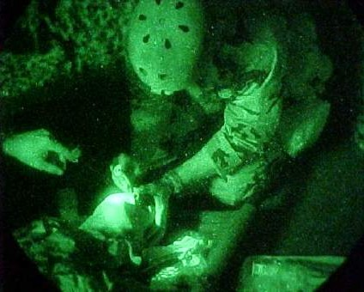
APPLICATION OF TCCC IN DIFFERENT ENVIRONMENTS
Module 1: Principles and Application of TCCC
VS
CIVILIAN OR MILITARY HOSPITAL SETTING
COMBAT OR AUSTERE FIELD SETTING

Slide 19
ROLES AND RESPONSIBILITIES OF ALL SERVICE MEMBERS
Module 1: Principles and application of TCCC
CARE UNDER
TACTICAL
FIRE/THREAT
FIELD CARE
In a CUF situation the
All Service Member should:
In a TFC situation, the
All Service Member should:
Ensure scene safety Move casualty to safety Identify and control
life-threatening bleeding
Rapid Casualty Assessment (RCA)
Follow MARCH sequence to render any treatments indicated
Seek help as directed by Unit Standard Operating Procedure(s)

Slide 20
ROLES AND RESPONSIBILITIES OF COMBAT LIFESAVERS
Module 1: Principles and application of TCCC
CARE UNDER
TACTICAL
FIRE/THREAT
FIELD CARE
In a CUF situation the Combat Lifesaver should:
Suppress hostile fire to minimize the risk of injury to personnel and minimize additional injury to previously injured Service members
Assist in providing self-aid and moving casualties, if feasible
In a TFC situation, the Combat Lifesaver should:
Maintain security and situational awareness
Perform casualty assessments Follow MARCH PAWS protocol
to render any treatments indicated
Support the CMC, as directed
▪
▪

Slide 21
Module 1: Principles and Application of TCCC
ROLES AND RESPONSIBILITIES OF THE CMC
CARE UNDER
TACTICAL
TACTICAL
FIRE/THREAT
FIELD CARE
EVACUATION CARE
The CMC should:
The CMC should:
The CMC should:
Suppress hostile fire to minimize risk of new or additional injury to previously injured Service members
Assist in providing self-aid and moving casualties,
if feasible
Assume the primary role for casualty assessment and treatment
Manage and direct the casualty response system utilizing all available responders
Reassess casualties for the arrival of evacuation assets
Communicate findings to the TACEVAC medical personnel
Ensure proper staging and support loading
Secure casualties on the evacuation platform

Slide 22

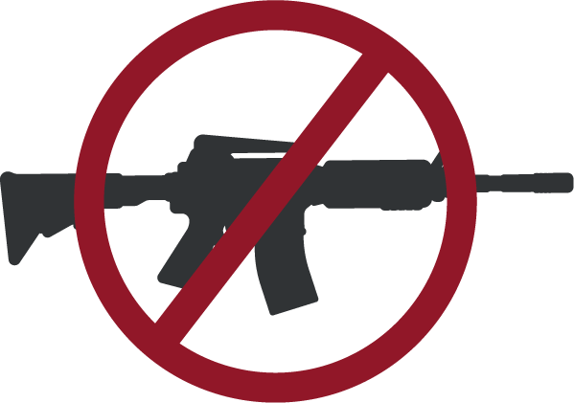
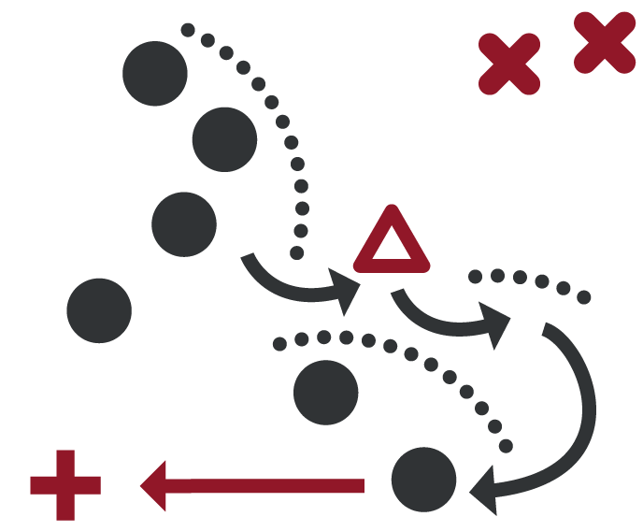
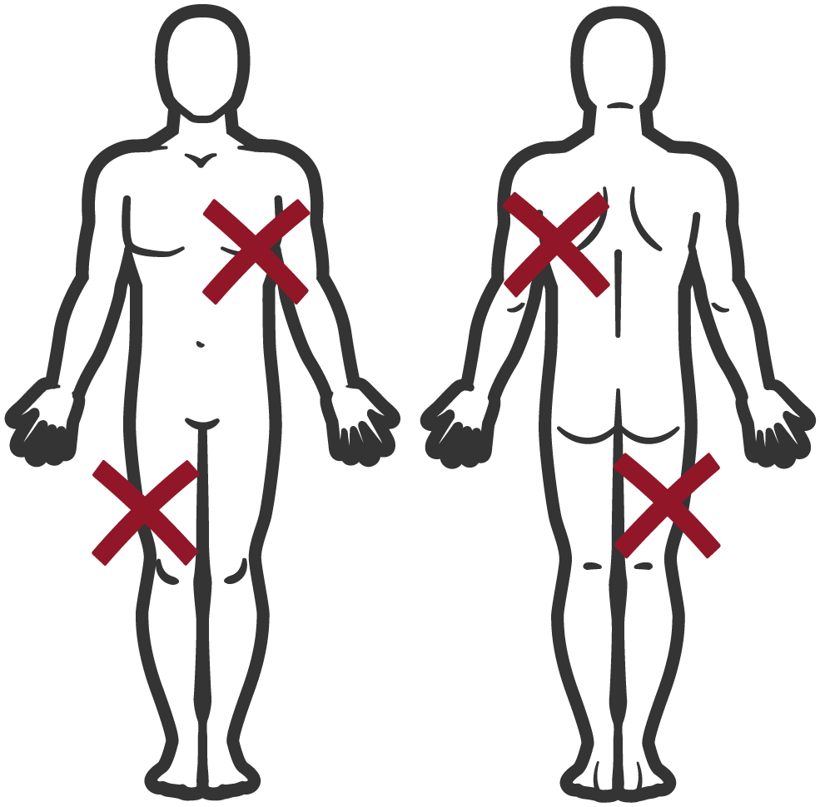
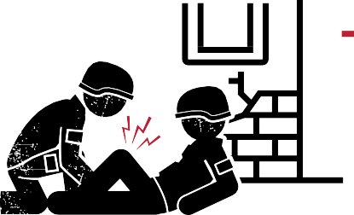

Module 1: Principles and Application of TCCC
THE KEY FACTORS INFLUENCING TCCC
Hostile fire
Tactical considerations
Wounding patterns
Environmental considerations
Level of first responder training and experience
Equipment constraints
Delays in reaching higher levels of care

Slide 23
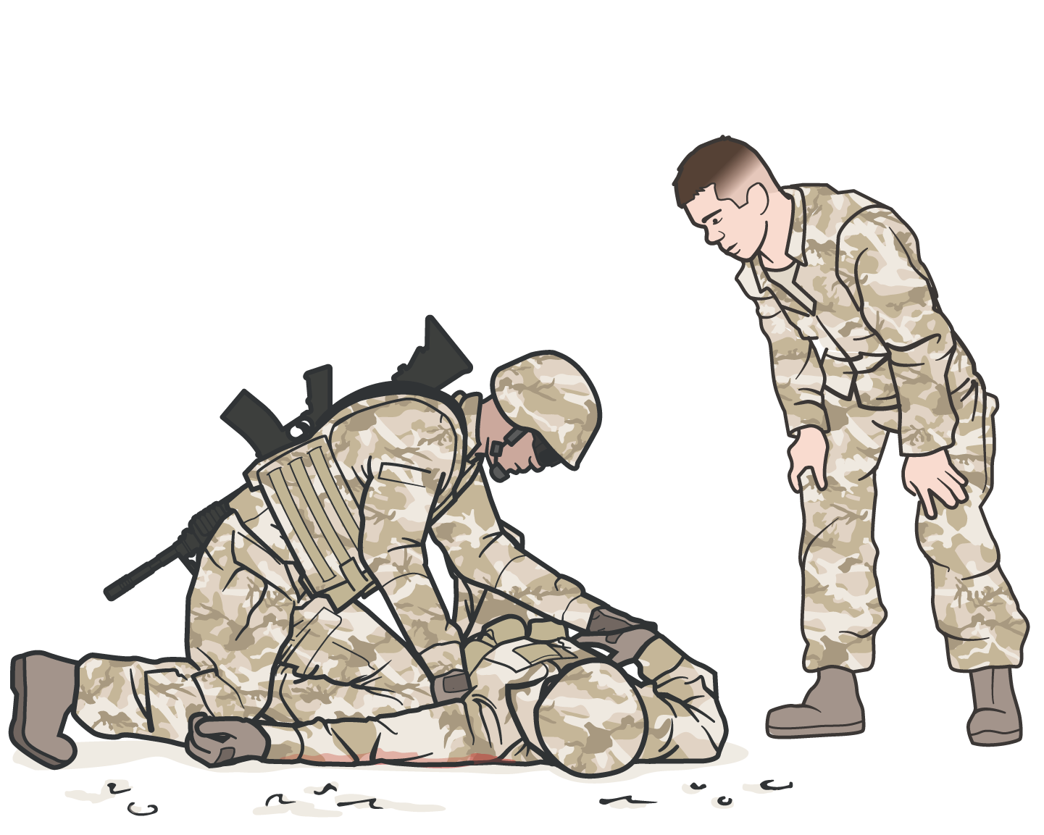
IMPORTANCE OF TCCC TRAINING
Module 1: Principles and Application of TCCC
Application of TCCC has resulted in the lowest preventable death rate ever
Individuals who are regularly
trained in TCCC are COMBAT-READY
when they deploy
Units that train together perform
more efficiently in an operational setting
During training, CMC can
identify outstanding performers to
use as extenders and first responders
who might benefit from additional mentorship

Slide 24

THE THREE OBJECTIVES OF TCCC
Module 1: Principles and Application of TCCC
Treat the casualty
Prevent additional casualties
Complete the mission

Slide 25







LIFESAVING IMPACTS OF IMPLEMENTING TCCC IN PREHOSPITAL TRAUMA CARE
Module 1: Principles and Application of TCCC
8 of 12
deaths from potentially survivable injuries might have been prevented by the proper application of TCCC principles

Slide 26

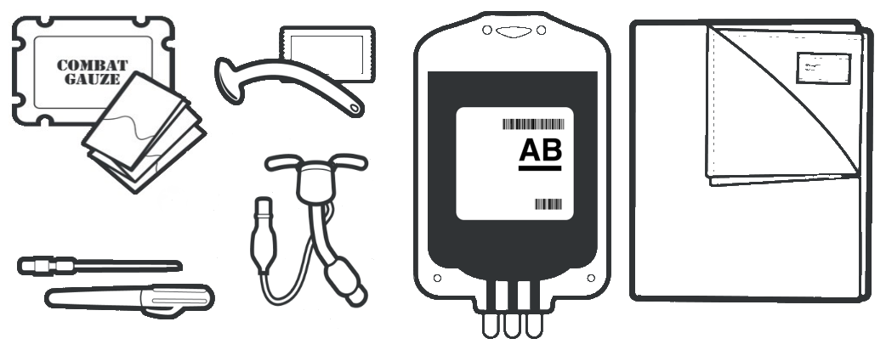
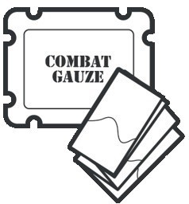
LIFESAVING IMPACTS OF IMPLEMENTING TCCC IN PREHOSPITAL TRAUMA CARE
Module 1: Principles and Application of TCCC
In addition to tourniquet guidance, many other TCCC advances have now been widely adopted
Including: hemostatic dressing and wound packing; junctional tourniquet, needle decompression of the chest, nasopharyngeal airway, cricothyroidotomy, extraglottic airway, resuscitation with blood products, and hypothermia prevention, to mention a few

Slide 27
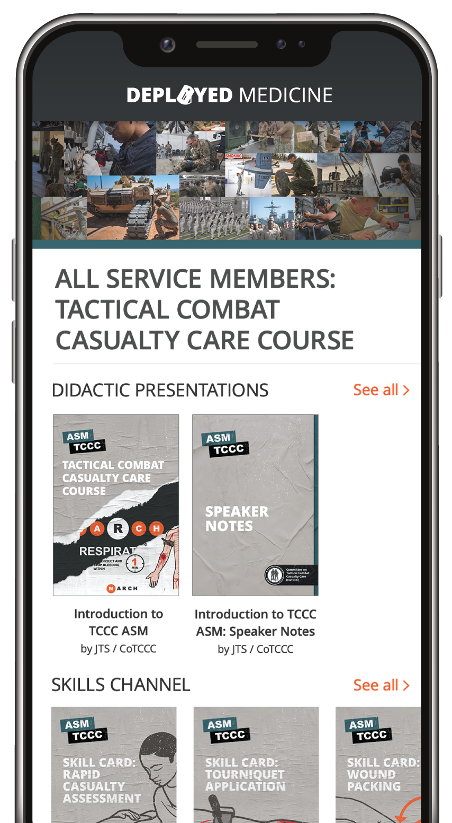
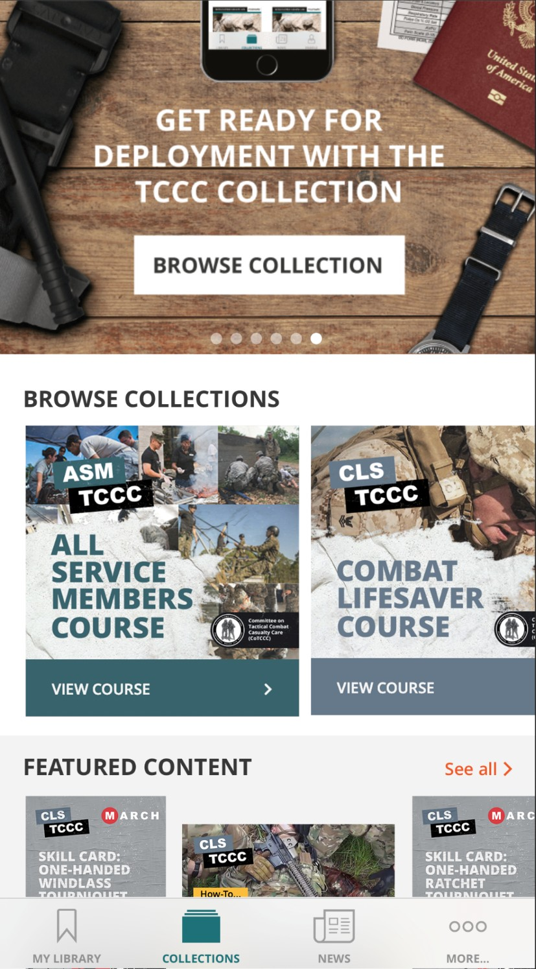

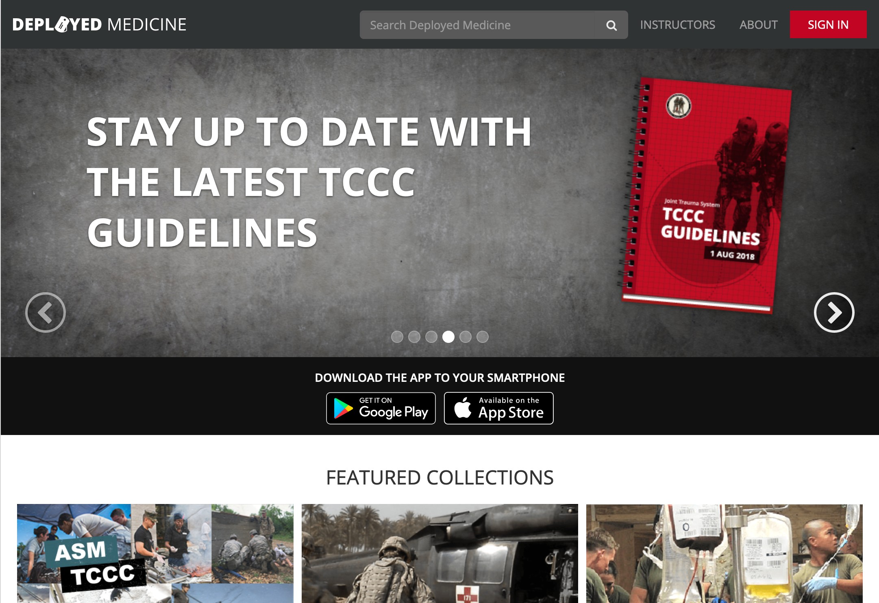
Module 1: Principles and Application of TCCC
STAYING UP TO DATE WITH TCCC GUIDELINES AND PROTOCOLS
The TCCC Guidelines are reviewed quarterly and updated as needed by CoTCCC
Once approved by the Director of the Joint Trauma System (JTS), the updated version of the TCCC Guidelines is published through:
www.deployedmedicine.com
Defense Health Agency
deployedmedicine.com
27

Slide 28
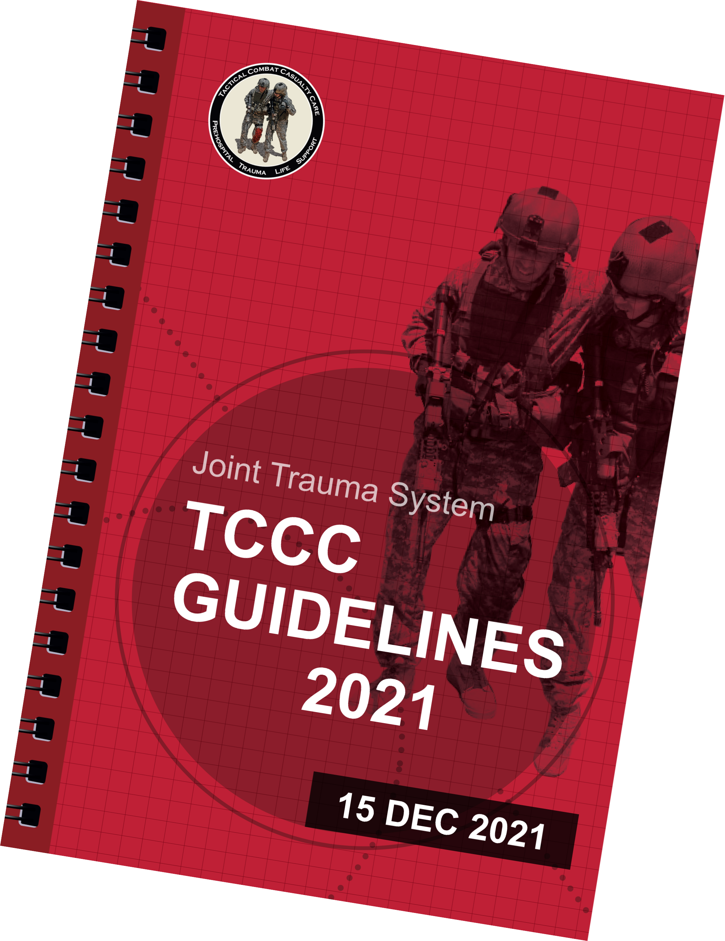
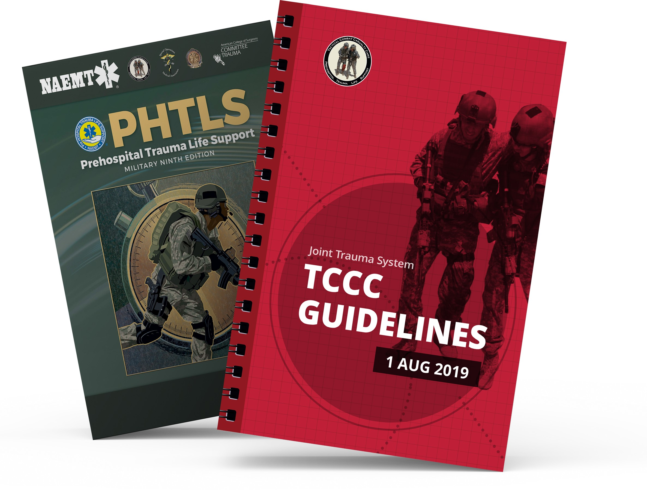
REFERENCES
Module 1: Principles and Application of TCCC
TCCC: Guidelines
by JTS/CoTCCC
These guidelines, updated regularly, are the result of decisions made by CoTCCC in exploring evidence- based research on best practices.
PHTLS: Military Edition
by NAEMT
Prehospital Trauma Life Support (PHTLS), Military Edition, teaches and reinforces the principles of rapidly assessing a trauma patient using an orderly approach.

Slide 29

CHECK ON LEARNING
Module 1: Principles and Application of TCCC
Which factors influence TCCC?
What are the phases of care in TCCC?
What is the most essential treatment task in CUF? What is every first responder’s role in CUF?
What does MARCH PAWS stand for?

Slide 30



Module 1: Principles and Application of TCCC
ANY QUESTIONS?

